Slide 1
Aerospace Design and Systems Engineering Elements II AE2111-II aircraft part
Weight estimation and iterations in a/c design
Dr. F. Oliviero
Flight Performance & Propulsion Group (FPP)

Slide 2
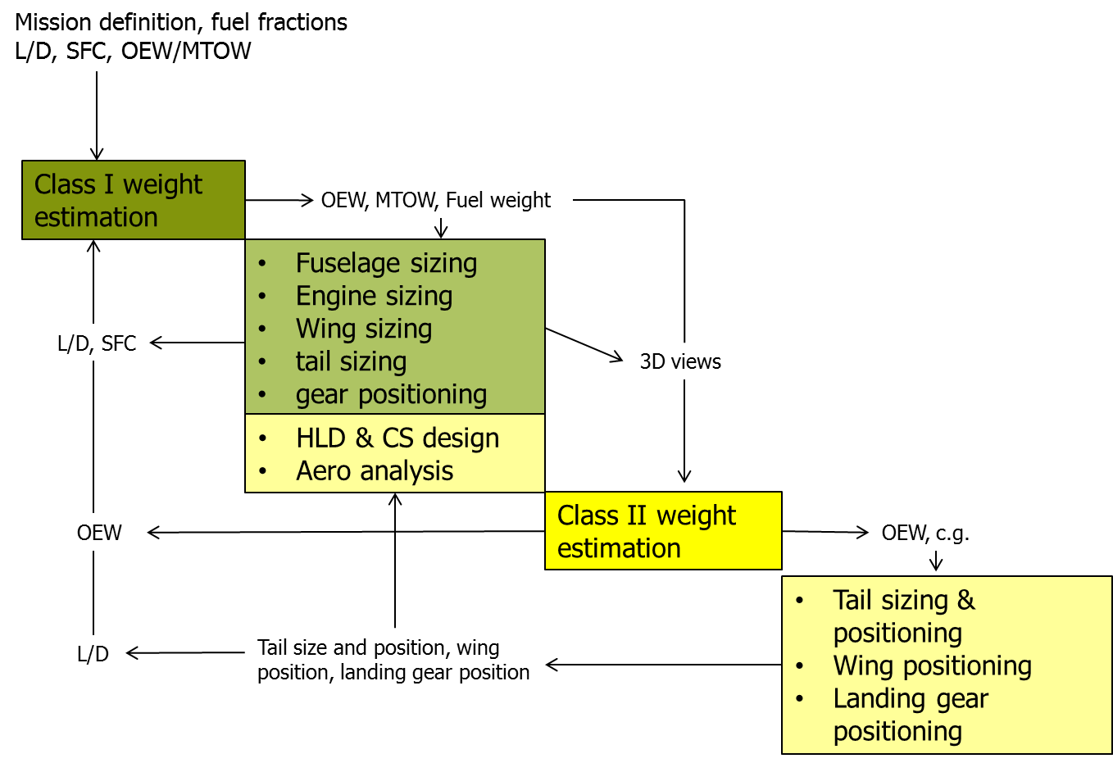
Contents of the lecture
One of the most important aspect to deal with during ALL the design stage:
How to calculate the MTOW? How to calculate the OEW?
Notes:
2

Slide 3
In this lecture you will …
understand the need and the available methods for weight prediction and control in the aircraft design process
learn to use so-called Class II component weight estimation methods, to predict the a/c operative empty weight
learn when and how to handle design iterations due to predicted weight changes during the aircraft design process

Slide 4
1: Importance of weight estimation

Slide 5
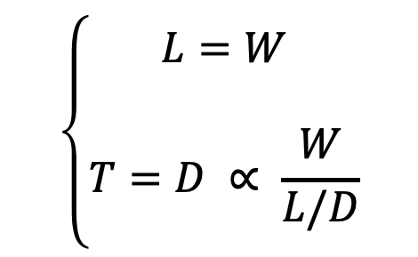
Weight and certification
Can you recall any explicit requirement on the aircraft weight?
CS23.1: ’’This airworthiness is applicable to – aeroplanes that have a maximum certified take-off weight of 8618 kg’’.
(else it is a CS25 aircraft)
Aircraft weight can be a main design driver it itself is NOT a (direct) goal of the certification process. Eventually, a certified (=safe) aircraft is not necessarily a commercially attractive aircraft.
BUT, the importance of the weight lies in the equilibrium equations:
In addition, weight does play an important role in the certification process*.
$$\left\{\begin{matrix}L=W \\ \\ T=D ∝ \frac{W}{L/D}\end{matrix}\right.$$
The market makes the weight a driving design parameter
Notes:
*weight is already determinant for the initial selection of the applying regulations (CS 23, CS 25, CS VLA). See AE1201 on certification requirements.
Certified limits are imposed on weights that vary during the flight and may be different for each flight**, in order to prevent overloading of the structure, unacceptable performance and unacceptable handling qualities.
**in particular, on maximum zero fuel weight MZFW, maximum take-off weight MTOW, and maximum landing weight MLW
MTOW = OEW + design payload + design mission fuel + reserve; spec defines conditions. It affects most structural components.
MLW = OEW + max. payload + reserve fuel + margin (high density). Mainly undercarriage related
MZFW = OEW + max payload + margin. Partially wing related.
Weight is important, for example, in the certification of field- and climb-out performance (OEI) because of safety.
For a certified aircraft any increase or decrease of the operational empty weight (OEW) is matched by an equal decrease or increase of the maximum (structural) payload. Hence, once the aircraft has been certified for a certain weight (e.g. MTOW), these weights cannot be changed without certifying the modified aircraft version.

Slide 6

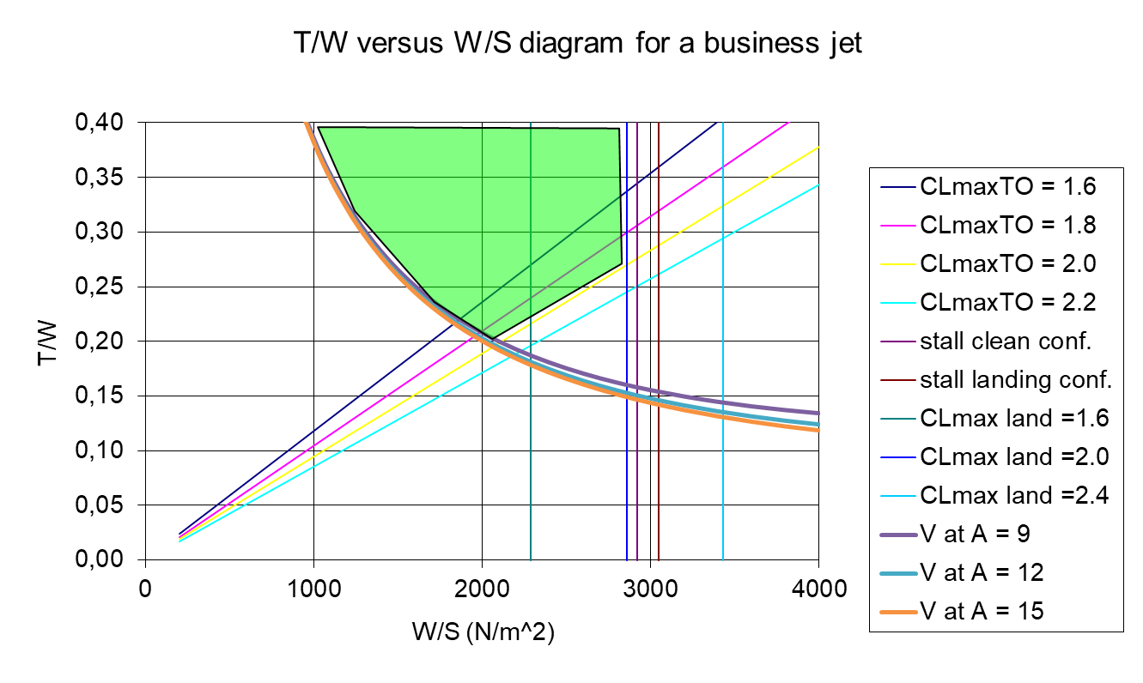
The problem of weight growth
Aircraft (components) weight has a tendency, just as for certain human beings, to increase over time and stubbornly refuses to drop.
The weight of the aircraft generally starts growing already during the design process….
The infamous snowball effect can largely increase the initial weight. If W increases, and you want to maintain:
- the same T/W → higher engine thrust required → more fuel required → fuel tank must increase → wing must be enlarged → higher OEW
- the same W/S → wing must enlarged and strengthened → undercarriage beefed-up → higher OEW
Notes:
*Apart from growing during the design phases (hence even before having built the first aircraft), it is proven that weight is actually continuing to grow also on actual flying aircraft. That is because of accumulating dirt, trapped fluids, incompletely removed layers of paints, repairs, absorbed humidity and condense.
During the design process, component weight increases lead to time consuming design iterations, because all strength computations have to be performed case by case and must be documented extensively for certification purposes.

Slide 7

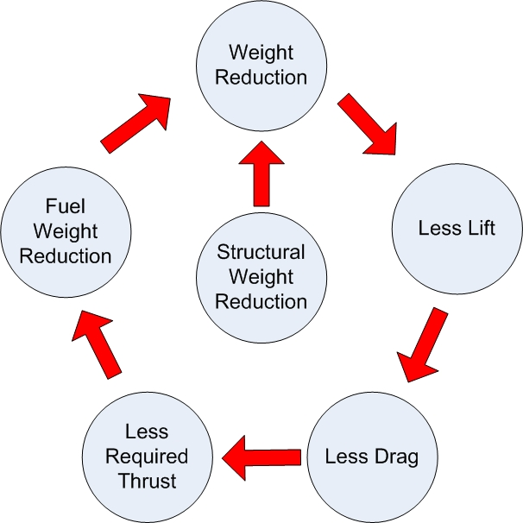
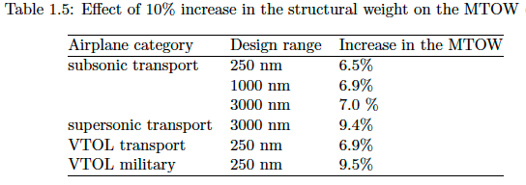
The problem of weight growth
An example of the “snowball effect”: any reduction in aircraft structural weight results in …
For a typical passenger aircraft with MTOW about 60,000 kg:
Reducing OEW by 1 kg, reduces MTOW by 2 kg!
Other problem: the weight keeps growing during the operational life!
Why is that?*
Notes:
*Apart from growing during the design phases (hence even before having built the first aircraft), it is proven that weight is actually continuing to grow also on actual flying aircraft. That is because of accumulating dirt, trapped fluids, incompletely removed layers of paints, repairs, absorbed humidity and condense.
During the design process, component weight increases lead to time consuming design iterations, because all strength computations have to be performed case by case and must be documented extensively for certification purposes.

Slide 8
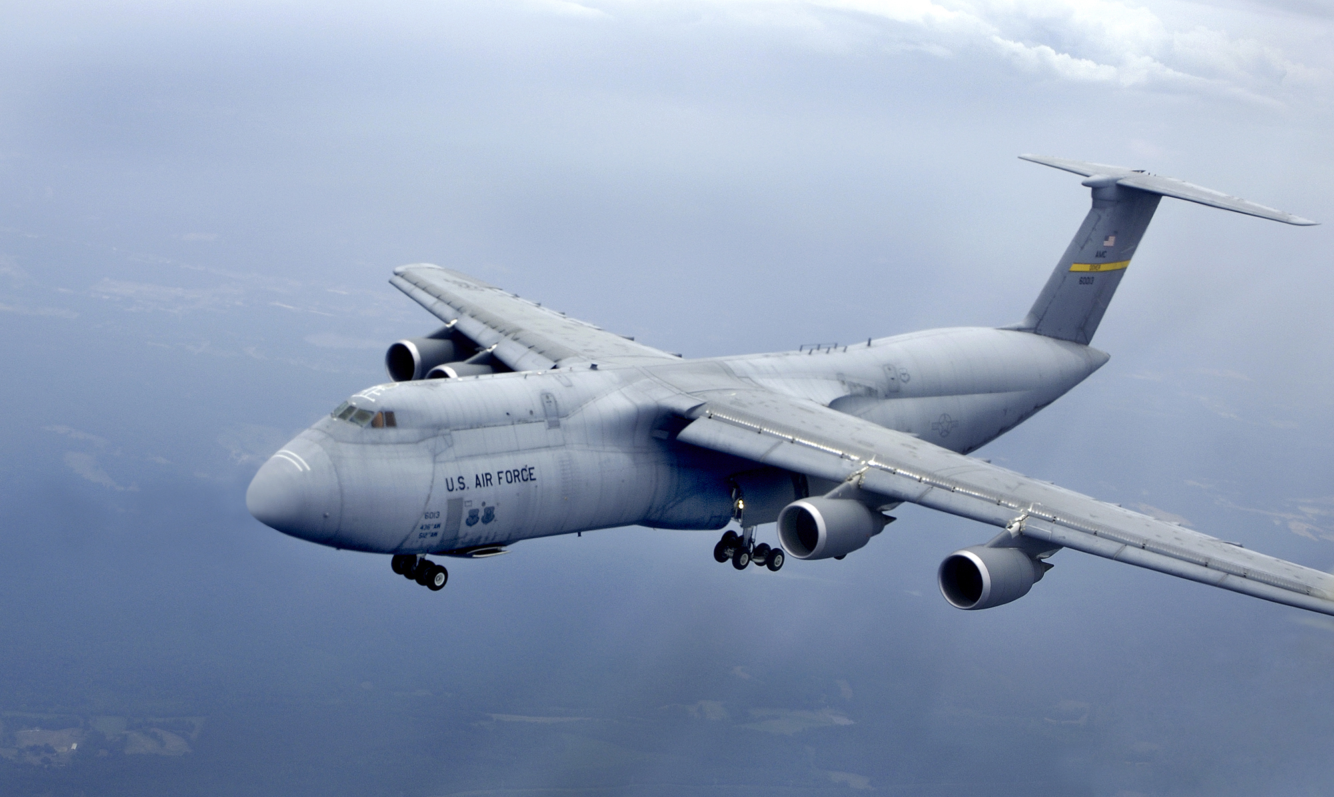
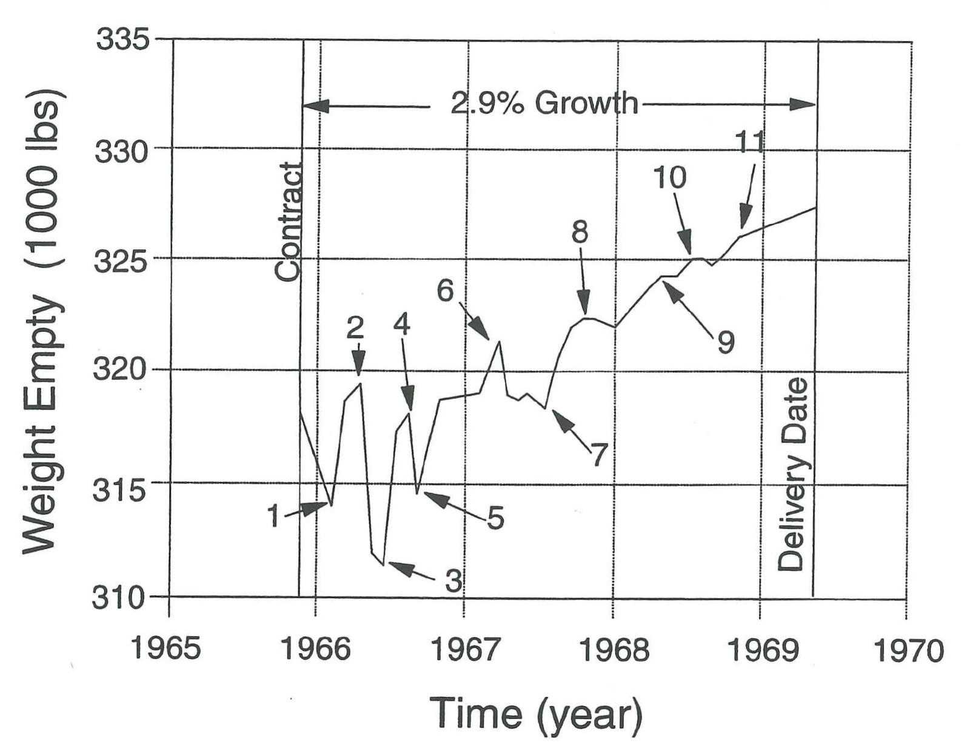
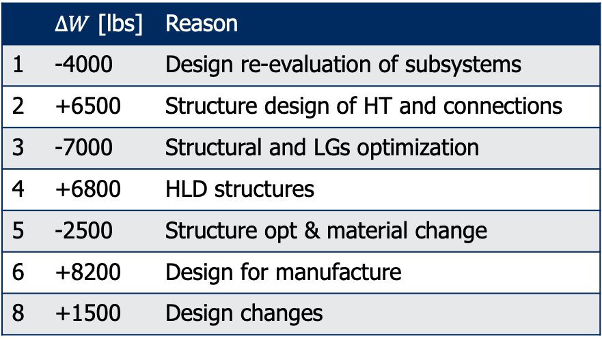
The problem of weight growth
Practical example of the weight growth during the design for the LM-C5A Galaxy
 | $∆W$ [lbs] | Reason
1 | -4000 | Design re-evaluation of subsystems
2 | +6500 | Structure design of HT and connections
3 | -7000 | Structural and LGs optimization
4 | +6800 | HLD structures
5 | -2500 | Structure opt & material change
6 | +8200 | Design for manufacture
8 | +1500 | Design changes
Notes:
Plot Source: Staton, R. N., Introduction to aircraft weight engineering, Society of Allied
Weight Engineers, Los Angles, California, 1996.

Slide 9

The problem of weight growth – Example 1
The Boeing 747-100 was initially designed to carry 350 passengers over 5,100 nm with a MTOW of 550,000 lb…..
.... but was finally certified with a MTOW of 710,000 lb (+29%).
The later B747-400 carried 416 pax (+19%) over 7,670 nm (+50%) with a MTOW of 910,000 lb (+28%) largely due to improved engine SFC.
→ Engine thrust for the Pratt & Whitney JT9D-7A had to be increased from 41,000 lb to 46,500 lb (+13.4%)
→ Take-off field length had increased from 8,000 ft to 11,750 ft (+47%)*
→ Initial cruise altitude had dropped from FL 350 to FL 310*
Notes:
* Evidently the wing was not enlarged, neither modified in its design: W/S was not kept constant (got higher) with the consequence of longer take off field and the need to fly at higher air density level (hence at lower altitude) to provide higher lift for the same design CL value provided by the (not modified) wing.

Slide 10
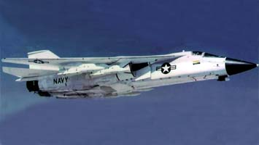

The problem of weight growth – Example 2
The General Dynamics F-111B was a notorious example of uncontained weight growth, effectively denying carrier vessel operation.
→ An aircraft carrier poses an absolute weight limit due to the catapult!!
A Super Weight Improvement Program (SWIP), was followed by the Colossal Weight Improvement Programs I, II and III - to no avail ☹.
That role was eventually performed by the Grumman F-14 Tomcat using the same engines, weapons and avionics.
Notes:
A sequel of super and colossal weight reduction programs could not cure a chronic degenerating problem.
The F111 case is often illustrated in Sys Engineering courses as example of bad weight contingence management. That is, the inadequate capability to keep under control the main characteristics (including the associated uncertainty) of a product during the evolving design phases.

Slide 11

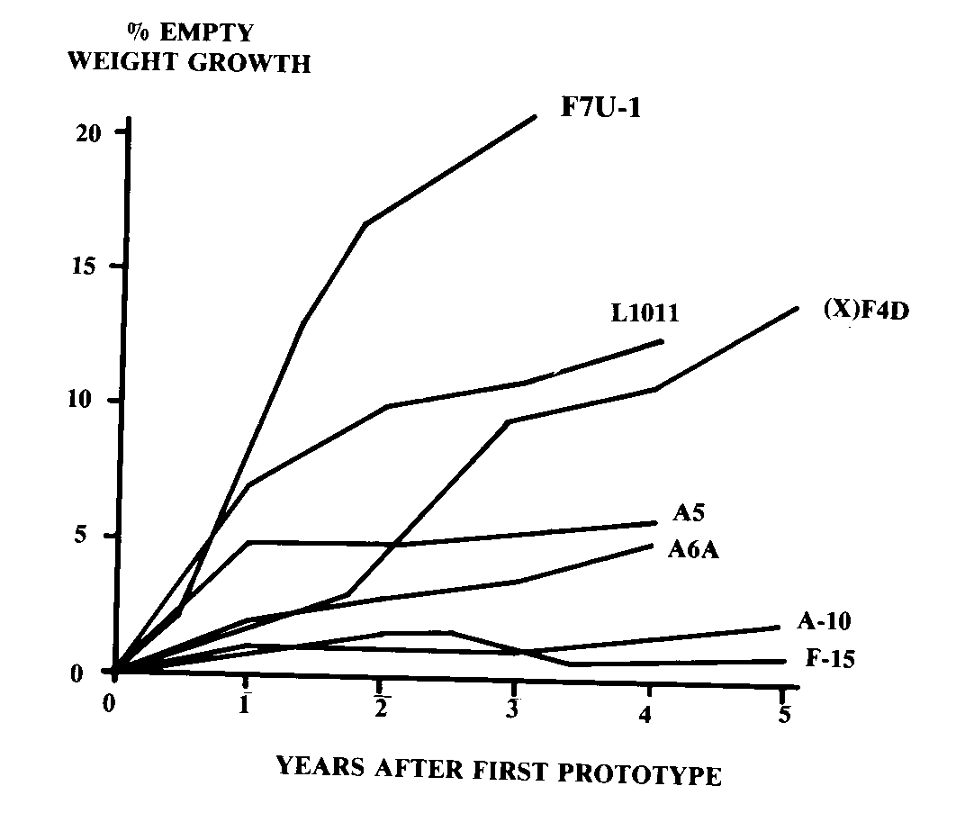


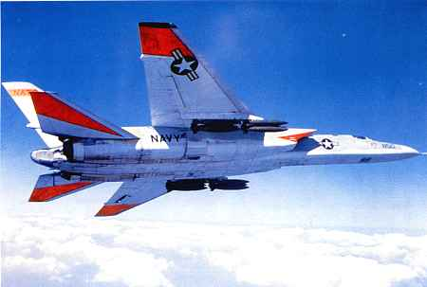
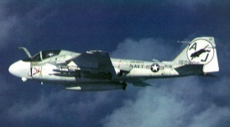

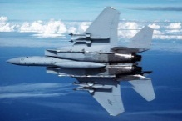
The problem of weight growth
An empty weight increase of 5% in the first year was common*
Today, better design techniques have reduced it to 2%.
One could account for this growth, by making use of a contingency factor for the aircraft empty weight (3-6%)
However, beware of self fulfilling prophecy!**
Notes:
Plot Source: Raymer.
*This growth was typically due to calculation and data inaccuracies, but also to changes in the avionics, additional weapon pylons, changes in structural solutions (use of heavy reinforcements), etc..
**The issue here is that too conservative weight specifications (in the attempt to account for the natural growth of components weight and to avoid a too optimistic approach) might result in structures that are just heavier because sized for higher loads. Indeed, many non-structural masses, like those of the many aircraft systems are typically estimated as a percentage of the MTOW or OEW. As a consequence, by assuming a heavier structure, certain systems and components will be sized to be larger and heavier, hence requiring an actually heavier structure to support them.
Hence, if badly managed, the weight growth might get just sustained by the use of contingency factors, rather than prevented.

Slide 12
The problem of weight growth
THE LESSON:
A highly accurate (first) weight estimate and a systematic weight control during the whole design process are of utmost importance for several reasons:
To limit the uncertainties
To limit design iterations
To freeze the design as soon as possible

Slide 13
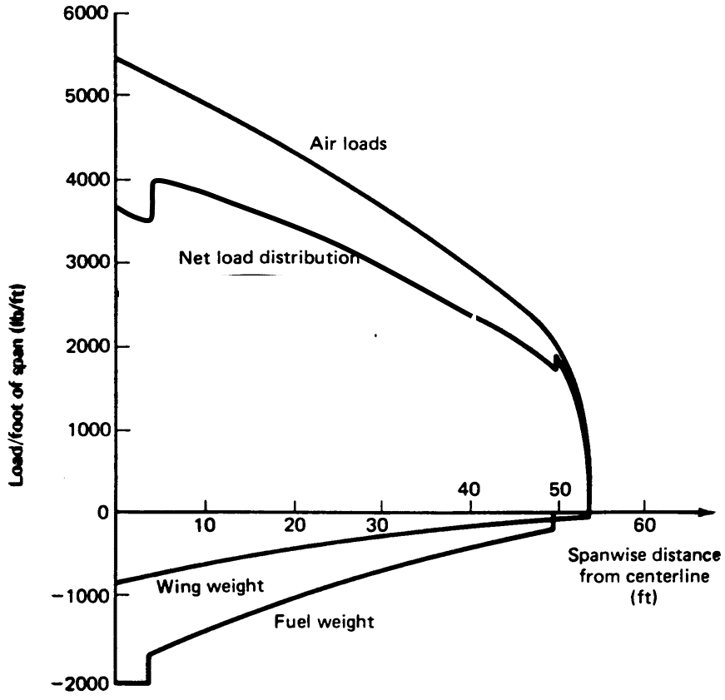

Example of wing weight prediction
Bending relief by wing and fuel weight
Let assume we want to perform the weight estimation of a wing
An appropriate prediction of the wing weight can be performed once the main wing structural components have been sized.
To perform the sizing, however, the critical wing load cases are required and it can depend also on how the weight is distributed along the wingspan.
…but the weight estimation is exactly the goal of the calculation!
?!
Notes:
Net load distribution= (air loads – (wing weight + fuel weight))
If the wing weight is not accounted, the sizing load case will be overestimated (no bending relief by the wing), hence the wing will be oversized (heavier)
How would you solve this chicken and egg problem??

Slide 14


Preliminary weight estimation. An occult science?
Weight is an indication of design quality, because that is where all disciplines come together*.
However, much more relevance is typically given to other specific disciplines, such as aerodynamics and control.
Besides (or as a consequence!), there is a terrible lack of available literature, and adequate (up to date) information and reliable weight data.
Industrial weight information is difficult to obtain for outsiders. Aircraft industries have developed in-house weight prediction methods. Since these contain sensitive design information, their essence is not published.
Most publications by industrial parties contain little (explicit**) information on modern aircraft and material applications.
SAWE: Society of Allied Weight Engineers
Notes:
*We can state the same about drag.
**A typical problem with data available in literature is the lack of explicit values. To prevent competitors from getting to much sensitive info, values are typically scaled, normalized, graphs are presented without scales, etc. Only group weights are given rather than single components weights, typically expressed in term of fractions.
Weight engineers are almost a sect, they have their “secret” methods, they have their own conferences and communities, which are often transversal to company boundaries. An example is the SAWE: the society of Allied Weight Engineers, which facilitate the exchange of information, data and methods for weight prediction.
Though weight engineers are dealing with highly confidential data and sensitive methods, they need to get good data to improve and calibrate their tools. However, apart from in house available data, other good data are only in the hands of competitors. Coffee breaks at conferences appear to be a good way to exchange some good and fresh data...
Quite amazingly, it looks like some more data are available of military aircraft than civil ones.

Slide 15
2: Classification of weight estimation procedures

Slide 16
Weight estimation in the a/c design process
Weight uncertainty
MTOW
During the conceptual design phase weight is estimated (or predicted, but not determined!) with simple methods based on aircraft mission analysis and largely doped with statistics. The results from these conceptual estimations feed the tools used in the following design phase.
During the preliminary design phase, weight is again not determined but estimated, using (semi-)analytical tools, based on a mix of load cases and statistical data…including the weight estimations from conceptual design!.
These estimates represent the design goals* (or weight specifications) for the structural and system engineers, who must design the actual structures (still in the preliminary design phase and later in the detail phase). These engineers use also sophisticated analysis and sizing methods, in order to achieve the best possible estimations.
Notes:
*In this respect the preliminary designer does not design, but predicts or specifies targets for the structure specialist and/or the aircraft system design
Indeed, actual weight calculations can be performed only when the aircraft is on the scale…..

Slide 17
Weight estimation in the a/c design process
What methods exist and when they are used
Class I: Early conceptual methods
or pre-configuration selection methods
When you know almost nothing about the aircraft, apart from its requirements*
Class II: Conceptual stage methods*
or configuration selection methods
When results from Class I are available, as well as a simplified geometric definition of the aircraft
Class III: Preliminary design methods
or post-configuration selection methods
When results from previous methods are available, plus tools for accurate aerodynamic analysis and structural sizing
---------------------- conceptual/preliminary design concluded -----------------
Class IV: Preproduction stage methods
When the exact geometry of each component and the characteristics of the material are known
Notes:
* The method illustrated in AE1201, is a typical example of Class I method, useful to estimate the maximum take off of a given aircraft, plus its payload, structure (Operative empty weight) and fuel weight fractions.
Only Class I and II methods are discussed in this series of design courses.

Slide 18
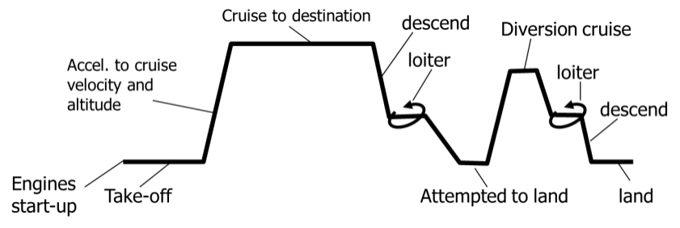
Conceptual design
Preliminary design
Detail design
CLASS I
Approach | Fuel fractions method (use of Breguet formulas)
Input | Payload, range, speed, SFC, prop efficiency, L/D statistic based fuel fractions estimation Statistic based OEW/MTOW estimation
Output | MTOW OEW Fuel weight (with reserves)
Covered in AE1201

Slide 19
Early conceptual weight prediction (Class I)
The weight data required during the early conceptual design phase are total aircraft group weights such as empty weight, payload weight, and take-off and landing gross weights.
Since the type of aircraft, speed, range, payload and technology level are generally the only design criteria available, the weight estimating relationships are preferably expressed in terms of this information (Breguet equation).
Reliable* statistical information on weight fractions of similar existing or projected (competing) aircraft can be helpful when interpreted carefully.
Covered in AE1201
Notes:
Depending on the approach to the design process, there may be also a requirement related to the weight sensitivity to varying wing area and installed thrust. A high weight sensitivity would imply large changes in the aircraft total weight as consequence of small change, for example, in the weight of the engine (installed thrust).
Hence, in case a different heavier engine should be installed on the given aircraft, the larger increase in OEW/MTOW would require a decrease either in the payload or in the fuel fraction.
*The relevance of the reliability of these statistical information will be discussed later, showing the sensitivity of the aircraft gross weight and performance to the use of bad reference data.

Slide 20
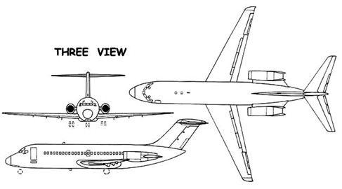
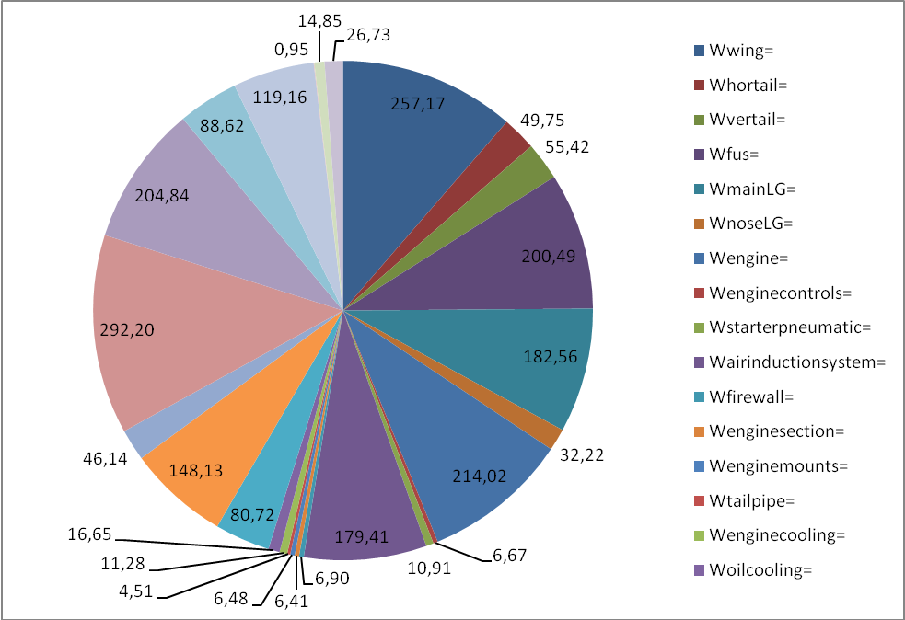
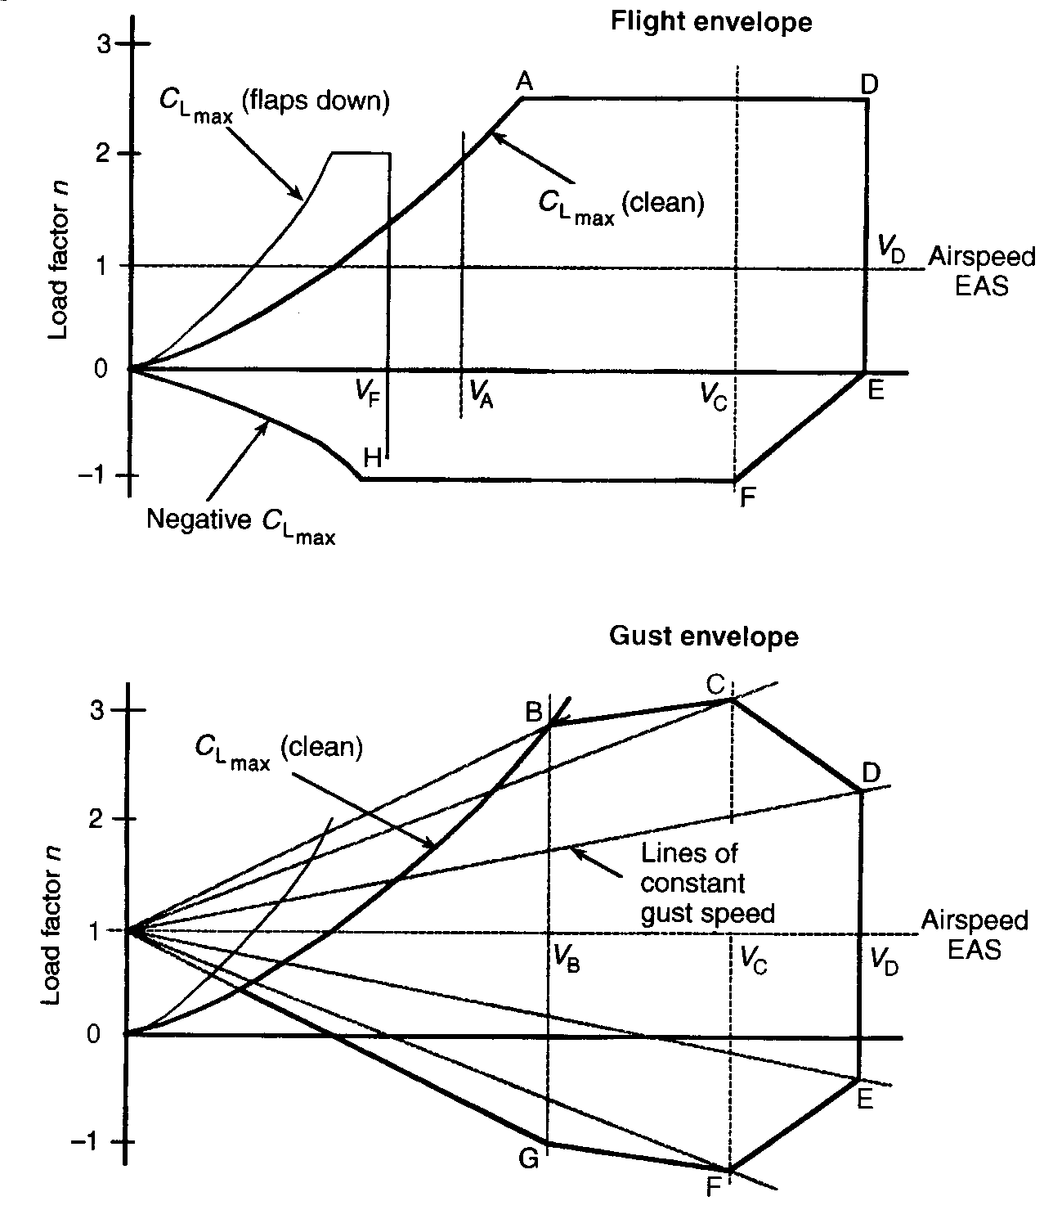
Conceptual design
Preliminary design
Detail design
CLASS II
Approach | Component weight estimation equations
Input
Output
MTOW, gross weight, OEW, MZFW, …
Load factors (n_{ult})
Geometric parameters (span, sweep, chord, t/c, taper, diameter, surface..)
Weights of a/c main components and systems
OEW
Covered in this course

Slide 21
Conceptual stage weight prediction (Class II)
Results of these conceptual weight prediction methods are the weight of the main aircraft components, as well as an educated guess of the c.g. location of each component*.
Input is formed by initial estimate of OEW, MZFW, MTOW, and take-off thrust, as well as an initial three-view drawings.
The limited amount of conceptual design optimization will also require some information on weight component sensitivity to variation of basic design variables such as wing area, aspect ratio, angle of sweep, type of high lift devices, etc.**
At this stage weight engineering is still augmented by statistical data.
Covered in this course
Notes:
*The evaluation of the position of the c.g during the various phases of the mission is addressed as the balance the aircraft.
** To apply class II methods, indeed it is required the availability of geometric data such as wing area, sweep angle, taper ratio, fuselage length. Hence data that you have learnt to derive during previous courses (AE2201, AE2101)
While Class I weight methods can be considered very “impersonal” (the aircraft is just an entity with some attributes as L/D, cj, etc.), Class II are “more personal” because their outcome reflects the design choices made to size the aircraft (e.g., the selected values for sweep angle, thickness ratio, taper and aspect ration, fuselage length and diameter, etc..)

Slide 22
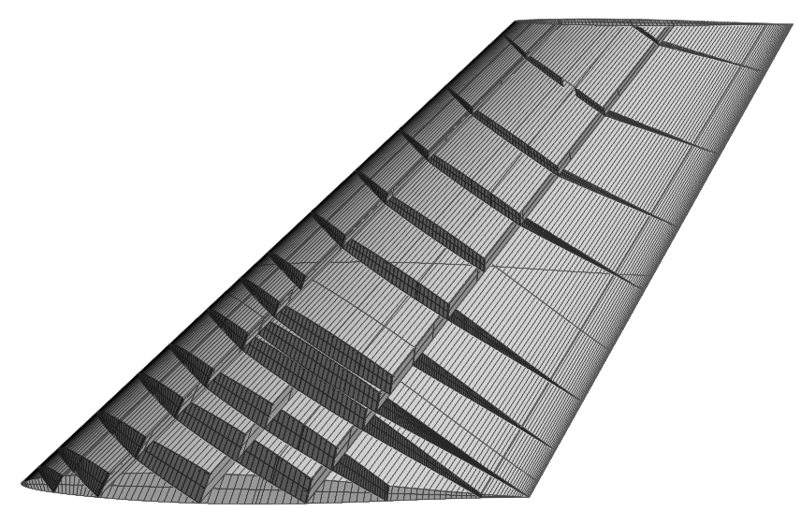
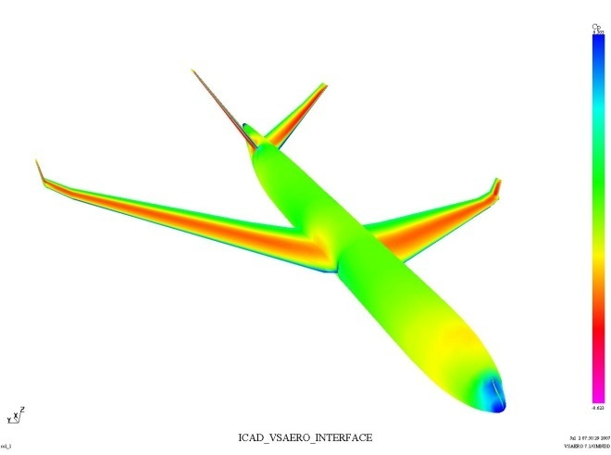
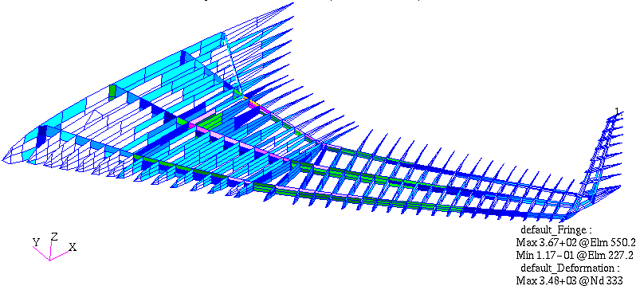
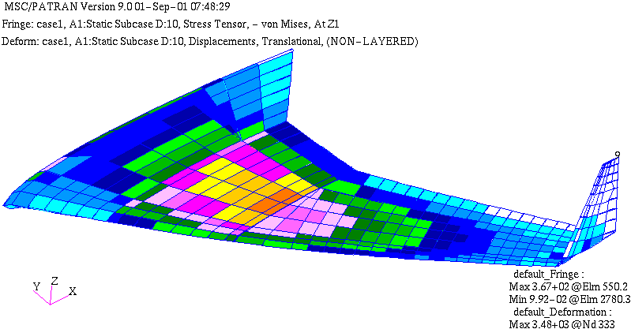
Conceptual design
Preliminary design
Detail design
CLASS III
Approach | Semi-analytical and FEM based methods
Input | Sets of (aero) load cases material data and allowables Preliminary CAD models of outer surfaces and internal structure layout (no production models) Preliminary thickness distributions Non-structural items masses
Output | Thickness distributions and weight of main structural elements (skin panels, spars, ribs, frames,…)
NOT covered in this course

Slide 23
Preliminary design weight prediction (Class III)
Weight engineering at this stage involves a detailed and well-defined breakdown of weight components and their c.g. locations at subsystem level, derived from refined loads analysis and preliminary structural sizing.
Since many of these use geometric information as input, a fairly detailed digital model of the a/c baseline design is required.
Results from preliminary design weight predictions represent input for performance and flight dynamics analysis, and for economic assessment.
NOT covered in this course series. (yet still in the hands of the conceptual/preliminary design group)
Notes:
* The weight of many aircraft systems, such as airco, cabling, piping etc. is strictly related to the geometry of the aircraft, rather than a specific load case (like the bending loads for a wing, or the pressurization for the fuselage, etc.). In fact, the weight estimation of those components, whose sizing is not related to any specific load case, is either specified, determined by previous calculations, or assumed on the basis of educated guesses.
In case of innovative (unconventional) aircraft configurations it might be necessary to anticipate the use of these more sophisticated sizing methods, since weights evaluated with heavily statistics based method (class 1 and class 2) can give very unreliable results.

Slide 24
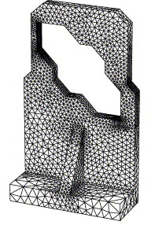
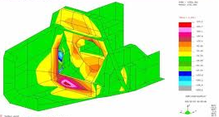
Conceptual design
Preliminary design
Detail design
CLASS IV
Approach | FEM based methods, Sizing handbooks, catalogues
Input | Load cases material data and allowables Detailed CAD models of all components (production ready)
Output | Detailed weight estimation of each single component
NOT covered in this course series

Slide 25
Preproduction stage weight prediction (Class IV)
A large amount of detail layout drawings is produced for a relatively consolidated design.
The associated weight engineering task is primarily maintaining an up-to-date and accurate inventory of detail masses and moments of inertia for all the items designed in-house and for those designed by external partners.
Large use of digital models to extract exact mass values of components
NOT covered in this course series. Not in the hands of the conceptual/preliminary design group

Slide 26
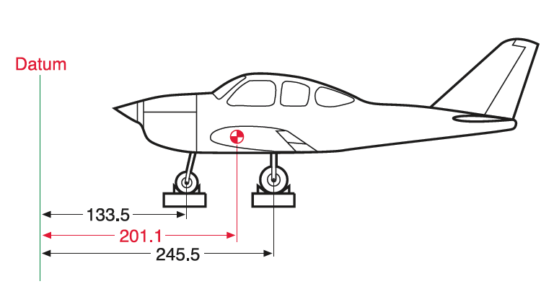
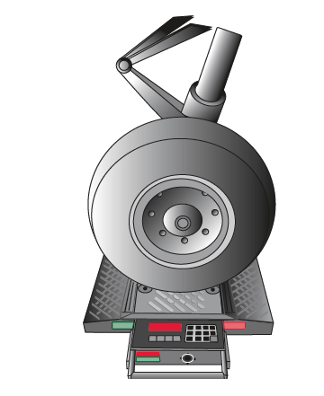
Conceptual design
Preliminary design
Detail design
CLASS > IV!
Approach | scale
Input | Aircraft
Output | Actual weight
There is no real weight estimation until the ready-to-fly aircraft is put on the scale
xxxx Kgf

Slide 27
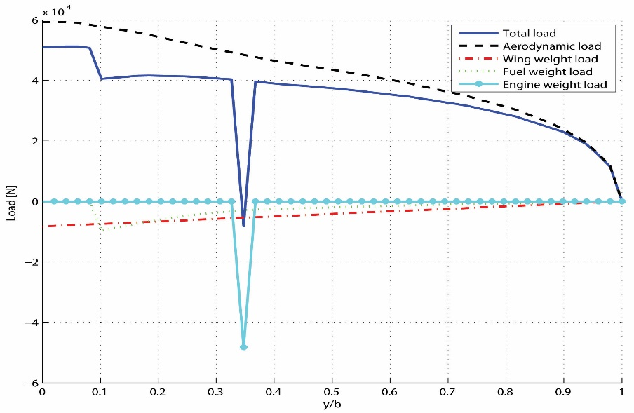
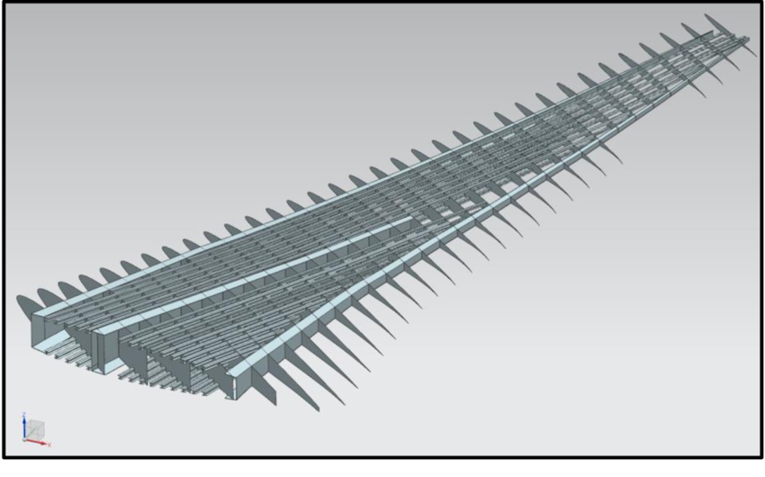
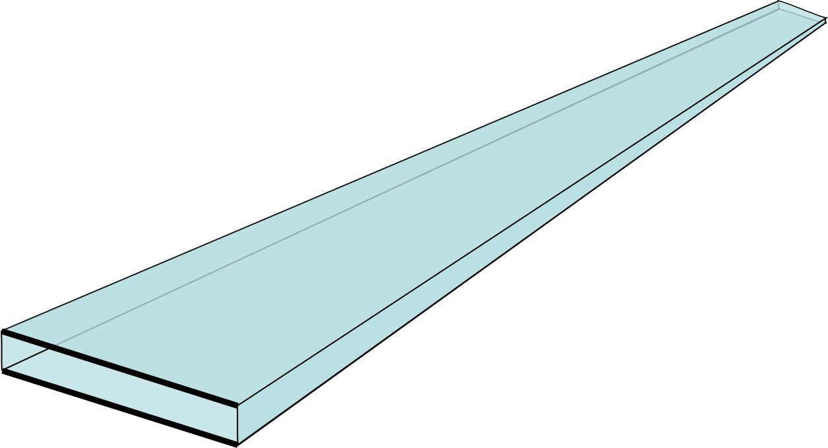
Conceptual design
Preliminary design
Detail design
CLASS II.5
Approach | Semi-analytical beam anaysis
Input | Sets of (aero) load cases material data and allowables Preliminary CAD models of outer surfaces and internal structure layout (no production models) Preliminary thickness distributions Non-structural items masses
Output | Thickness distributions and weight of the main structure
NOT covered in this course

Slide 28
2: Class II weight estimation methods

Slide 29
Weights: what are we talking about…
airframe services
and equipment
(total) fuel
rest fuel
block fuel
removable
fuel at landing
operational items
pre-take-off
fuel
propulsion
group
standard
item
variations
payload
airframe
structure
standard
items
reserve
fuel
additional
fuel
trip
fuel
fixed
MEW
Manufacturer’s empty weight
DEW
(Delivery) empty weight
BEW
Basic (empty) weight
Disposable load
OEW
Operational empty weight
Useful load
ZFW
Zero fuel weight
Fuel at take-off
TOW
Take-off weight
RW
Ramp weight
LW
Landing weight
GW
Gross weight
Burnoff fuel
OW/ZPW
Operating weight
Payload
Notes:
Before start looking in detail at the various weight estimation methods, it is convenient to refresh the typical weight definitions used in literature.
The take-off weight is the weight of the aircraft at the moment of brake release, or start of the take off run. It depends on the given loading condition (amount of payload and fuel on board) and can never exceed the maximum take off weigh (MTOW, which is generally fixed by structural requirements in the take-off)
The ramp weight is the take off weight plus the weight of the fuel required to engine starting and warm up and taxing. It cannot exceed the maximum ramp weight (MRW). This can be limited by airport ground constraints
The landing weight is the weight of the aircraft at the moment of touchdown. It cannot exceed the maximum landing weight (MLW, which is generally limited by the landing gear strength or the landing impact loads on some part of the structure. It cannot be higher than MTOW)
The gross weight, or design gross weight, is the total airplane weight at any moment during flight. At the moment of brake release before take off, it coincides with take off weight (TOW). This is a figure typically used for components weight estimation. It does not necessarily coincide with the take off weight, because designer might want to account that certain design loads are not met by the aircraft at MTOW, but only in certain phases of the mission, when part of the fuel has been already burnt (and the weight is then equal ….to the gross weight!). E.g., the weight of certain components is driven by loads that are typically encountered during cruise or at landing. Using the MTOW as reference, might yield overestimation of the component weight.
The operating weight (OW), or Zero Payload weight (ZPW), is the weight of the fully loaded airplane, without payload. So it is equal to the Operative empty weight (OEW) plus the total fuel.

Slide 30
Weights: what are we talking about…
airframe services
and equipment
(total) fuel
rest fuel
block fuel
removable
fuel at landing
Operational empty weight
payload
Fuel
pre-take-off
fuel
operational items
airframe
structure
propulsion
group
standard
item
variations
additional
fuel
trip
fuel
standard
items
reserve
fuel
fixed
Manufact. empty weight
(Delivery) empty weight
Basic (empty) weight
Disposable load
Operational empty weight
Useful load
Zero fuel weight
Fuel at take-off
Take-off weight
Ramp weight
Landing weight
Gross weight
Burnoff fuel
Operating weight
Payload
Notes:
To the eye of a class I weight estimation method, the weight breakdown of an aircraft consists only of the structural, payload and fuel weight. Nothing more detailed than that!

Slide 31
Weights: what are we talking about…
airframe services
and equipment
(total) fuel
rest fuel
block fuel
removable
fuel at landing
operational items
pre-take-off
fuel
propulsion
group
standard
item
variations
payload
airframe
structure
standard
items
reserve
fuel
additional
fuel
trip
fuel
fixed
Basic (empty) weight
A class II estimation method provides the weight of several components:
Airframe structure
- Wing group (includes wing, wing center section, and all moveable's)
- Tail group (includes stabilizer(s), fin(s), elevator(s), rudder(s))
- Body group (fuselage, including doors, fus. mounted speed brakes)
- Landing gear* group (main and nose gear, tail bumper)
- Surface controls group** (cockpit control, autopilot, system controls)
- Engine section or nacelle*** group (but not the engine!)
Notes:
*also called alighting gear group
** it is the weight of the control system not of the controlled surfaces
***includes engine mounts, nacelles, pylons, engine cowlings, noise suppression material, firewalls.

Slide 32
Weights: what are we talking about…
airframe services
and equipment
(total) fuel
rest fuel
block fuel
removable
fuel at landing
operational items
pre-take-off
fuel
propulsion
group
standard
item
variations
payload
airframe
structure
standard
items
reserve
fuel
additional
fuel
trip
fuel
fixed
Basic (empty) weight
A class II estimation method provides the weight of several components:
Propulsion group
Engine installation
Air induction system
Exhaust system
Powerplant controls, starting and ignition system
Fuel system*
Propeller installation
Thrust reverser
Notes:
*the part directly connected to the engine

Slide 33
Weights: what are we talking about…
airframe services
and equipment
(total) fuel
rest fuel
block fuel
removable
fuel at landing
operational items
pre-take-off
fuel
propulsion
group
standard
item
variations
payload
airframe
structure
standard
items
reserve
fuel
additional
fuel
trip
fuel
fixed
Basic (empty) weight
A class II estimation method provides the weight of several components:
Airframe services and equipment 1/2
Auxiliary Power Unit (APU)
Instrumentation, navigational equipment & electronics
Hydraulic, Pneumatic & Electrical systems
Fuel system*
Air conditioning, pressurization and anti-/de-icing systems
Furnishing and equipment** (see details in next slides)
Notes:
* The part collocated in the wing, tail and fuselage and not directly attached to the engine
**In the order of half the fuselage structure weight
While the weight of many of these items is reducing due to more efficient isolating materials and more efficient APU engines and airco systems, the electronics contribution is continuously increasing.
On the other hand, pneumatic systems are actually disappearing.

Slide 34
Weights: what are we talking about…
airframe services
and equipment
(total) fuel
rest fuel
block fuel
removable
fuel at landing
operational items
pre-take-off
fuel
propulsion
group
standard
item
variations
payload
airframe
structure
standard
items
reserve
fuel
additional
fuel
trip
fuel
fixed
Basic (empty) weight
A class II estimation method provides the weight of several components:
Can be in the order of 50% of fuselage airframe weight!
Airframe services and equipment 2/2
Furnishing and equipment items:
Flight deck accommodations: crew seats, instruments, floor covering, trim, wiring
Passenger cabin accommodations: pax and attendants seats, lavatories, galleys, tapestry, panels, partition walls, doors, wardrobes, IFES
Cargo accommodations: containers and cargo handlings provision, partition panels
Standard emergency equipment: fixed oxygen system, fire detection systems, evacuation slides
Notes:
Part of the removable weight consists of services and equipment which is installed on the aircraft by the manufacturer, and part which is installed - after delivery - by the operator

Slide 35
Weights: what are we talking about…
airframe services
and equipment
(total) fuel
rest fuel
block fuel
removable
fuel at landing
payload
pre-take-off
fuel
operational items
airframe
structure
propulsion
group
standard
item
variations
additional
fuel
trip
fuel
standard
items
reserve
fuel
fixed
Operational empty weight
Can be in the order of 5-10% of MTOW!
Operational items:
Flight/cabin deck crew (with provisions*)
Pax cabin supplies: containers, trolleys & galley inserts, food, drinks, magazines, pillows
Potable water, toilet chemicals and lavatory supplies
Safety equipment: life jackets
Oil in engines & Unusable fuel (trapped fuel)**
Cargo handling equipment: pallets, containers
Notes:
*crew baggage, pilot manuals.
**The trapped oil and fuel (fuel which remains permanently unutilized in some parts of the tanks) is generally accounted in the airframe service weight, rather than in the operational items. It can be as heavy as 0.1-0.5% of the aircraft take off weight.

Slide 36
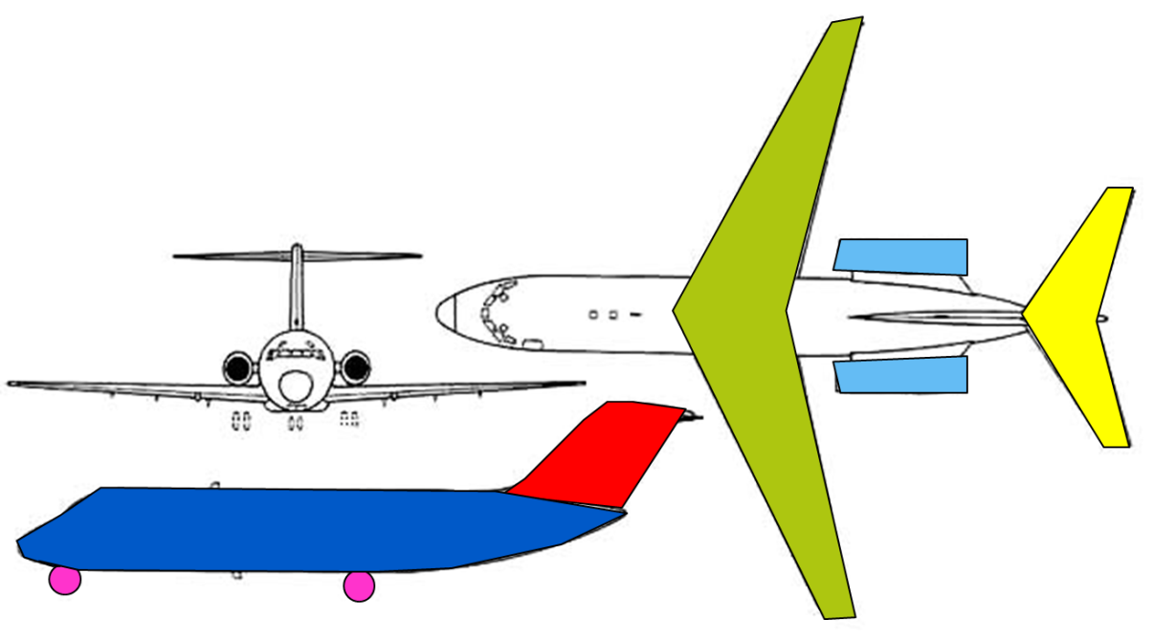
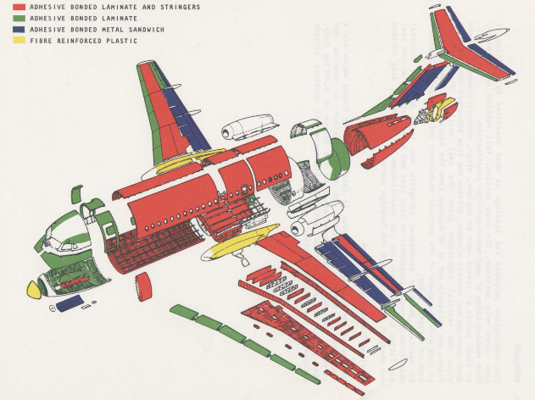
Class II weight estimation methods….
… cannot predict the weight of single structural details (e.g. ribs, spars, frames, etc.)
… are good in estimating the weight of component groups (e.g. wing, fuselage, Hor. and Ver. tail, landing gears, etc. and their main subsystems)
…allow the user to evaluate the sensitivity of the weight to a number of relevant design parameters such as:
Sweep angle
Taper ratio
Wing span
Wing thickness
Fuselage length and diameter
…

Slide 37
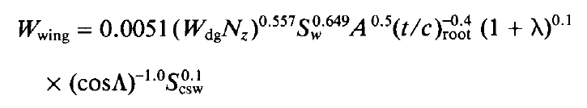
Examples of a Class II weight estimation methods
A typical class II rule combines relevant geometry (and inertial) parameters and corrective coefficients to account, e.g., for engines and landing gear installation, presence of door cut-outs, as well as for sizing load cases (N_{z}).
The values of the corrective coefficients derive from statistical regression and they are related to specific unit of measure: pay attention!!!
Example: the above equations return the weight in lbs only if the other parameters are expressed in imperial units.
Check the methods reported in the BrightSpace page (.zip folder)!
Notes:
Source Raymer
Note how the relations above capture the typical dependency of component weights (in this case the fuselage and the wing) with geometrical parameters such as fuselage slenderness ratio, wing aspect ratio, surface, etc.
Note also the dependency on Nz, which is the ultimate load factor for the aircraft under consideration. Indeed the weight of the structure is related to the loads it is supposed to carry.
As a matter of fact, wing weight depends also on lift distribution and the presence and integration of the fuel tanks, however these issues are rather difficult to be captured by class II methods. On the other hand, the effect of the taper ratio and the sweep angle are accounted, which actually affect the lift distribution on the wing. On the contrary, twist and wing incidence angle are not accounted in most of the Class II methods, although they can largely influence the lift distribution (hence the wing loading and sizing).

Slide 38
Examples of a Class II weight estimation methods
Let’s have a look on the wing weight equation:
Iterative calculation!
S_{w} = wing surface
A = aspect ratio
t/c = wing thickness ratio
λ = wing taper ratio
Λ = wing sweep angle
S_{csw} = control surface area
W_{dg} = Design gross weight
Can you see the effect of the main wing design parameters on the wing weight?
Notes:
Formula source: Raymer
* The method proposed by Raymer does not allow distinguishing between a wing podded engine and a fuselage podded engine configuration in terms of wing weight estimation. This is an apparent limitation of the method. Similarly it does not allow assessing the effect of fuel tanks in the wing or not. While the second limit is mostly common to all class II weight estimation, the first issue is well covered by the Torenbeek method, for example.
As a matter of fact, the wing weight depends also on lift distribution, however this is only partially captured by this method, through the taper ratio and the sweep angle, which actually affect the lift distribution on the wing. On the contrary, twist and wing incidence angle are not accounted in most of the Class II methods, although they can largely influence the lift distribution (hence the wing loading and sizing).

Slide 39
Examples of a Class II weight estimation methods
Let’s have a look on the wing weight equation:
Even if the values of the factors are determined by some statistical regressions, the dependences of the wing weight on the geometric parameters can be physically explained:
Higher the aspect ratio, higher is the weight because, for the same wing area, the larger aspect ratio means longer span and smaller chords so that the bending moment is increased.
Higher the sweep angle, higher is the weight because the structural length of the wing increases
Higher the t/c lower the weight , because of the higher moment of inertia contrasting the bending moment
…
Notes:
Formula source: Raymer
* The method proposed by Raymer does not allow distinguishing between a wing podded engine and a fuselage podded engine configuration in terms of wing weight estimation. This is an apparent limitation of the method. Similarly it does not allow assessing the effect of fuel tanks in the wing or not. While the second limit is mostly common to all class II weight estimation, the first issue is well covered by the Torenbeek method, for example.
As a matter of fact, the wing weight depends also on lift distribution, however this is only partially captured by this method, through the taper ratio and the sweep angle, which actually affect the lift distribution on the wing. On the contrary, twist and wing incidence angle are not accounted in most of the Class II methods, although they can largely influence the lift distribution (hence the wing loading and sizing).

Slide 40
Examples of a Class II weight estimation methods
The corrective coefficients have been derived on the base of extensive databases of actual aircraft weights using regression analysis.
Hence, these rules can well predict the weight of designs that do not differ significantly from those included in the database
That is why different sets of rules have been defined for different aircraft categories
That is why you should not trust “universal” weight prediction formulas
Notes:
Source Raymer

Slide 41
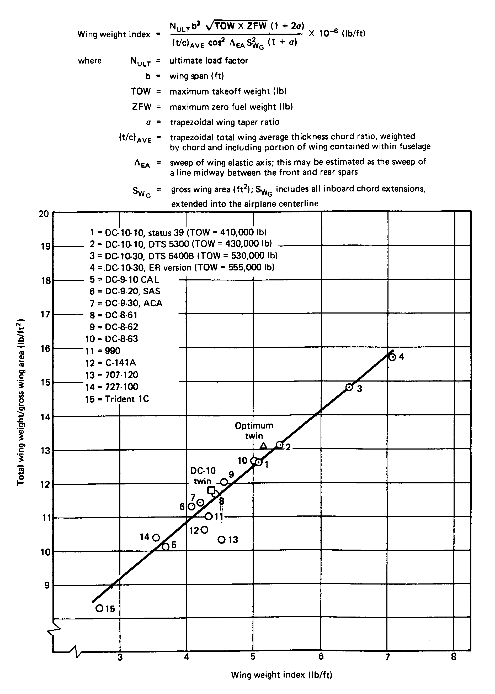
Example of Class II wing weight estimation method
Example of Class II weight estimation rule for wing
Strangely enough, it does not account for the possible installation of engines on the wing*
Notes:
*This method was proposed by R.Shevell in his textbook “Fundamentals of Flight”. Shevell was Douglas engineer, as you might suspect from the large amount of Douglas aircraft data in the plot above. While his method gives good results for wing of fuselage podded engines aircraft, it is not able to predict properly the weight of typical Boeing and Airbus wings (which are all wing podded engine configurations). Indeed it is based EXCLUSIVELY on Douglas type of aircraft
So, again, be critical before deciding what method to apply!od blindly!

Slide 42
Notes on Class II Weight estimation accuracy. Read before use
Different methods may vary in the way components and systems are grouped.
E.g. one method might include the weight of the wing center section in the fuselage weight estimation; another in the wing weight estimation of the wing.
Therefore, weight estimates from one method should never be combined with those from another method.
Notes:
**never say never: sometime you do not have other choice, however just make sure that you are not accounting twice or just neglecting the contribution of certain components/systems. E.g. some wing weight estimation accounts for the weight of movables surfaces and flaps. Other methods deal with flaps and other movables separately. Some methods include the weight of the wing/fuselage fairing or of the wing center box into the wing group, others into the fuselage group. Try to find information concerning these assumptions before using (and especially mixing) more weight prediction methods.

Slide 43
Notes on Class II Weight estimation accuracy. Read before use
Large errors may be observed for predicted component weights, but much better correlation is found for their summation (e.g. group weights* and Manufacturing Empty Weight MEW).
This is because group weights (and not single component weights) are generally used to calibrate the prediction method.
The reason is that group weighs data are more often available than single components weight values**
Therefore, do not rely too much on the accuracy of single component weight prediction
Notes:
*e.g., wing group weight, or tail group weight, or fuselage group weight (see slide 25 on Airframe weight)
**wing movables, tail rudder, main landing gear wheels, components of the cabin interior.

Slide 44
Notes on Class II Weight estimation accuracy. Read before use
For structural components there are many load cases, but only one is chosen for the computational model.
The critical load case is not always directly apparent.
Hence, models based on the estimation of structural load cases are often inaccurate.
Generally, the aforementioned equations apply only for metal structures. However, correction factors can be found in literature to account for the use of composite materials.
Notes:
Anticipating shortfalls during the development process, aircraft manufacturers give range guarantees to airlines that deviate up to 5% from the nominal values.

Slide 45
Weight estimate tailoring
Calibration/fudge factors
The quality of the calculated weight estimate W_{calc}, can be checked by comparing it to more reliable data, e.g., from more detailed and accurate calculations or, even better, from experimental data, i.e. W_{exp}*.
The ratio between W_{exp} and W_{calc} is the so-called calibration or fudge factor.
Multiplying each new weight estimate by this factor is supposed to improve the quality of the weight estimation (→ W_{est}):
Calibration factor
Notes:
*The experimental data, of course, must be from a very similar case to the one under estimation.
Large errors may be observed for predicted component weights, but much better correlation is found for their summation (e.g. group weights and Manufacturing Empty Weight MEW). This is because group weights and not single component weights are generally used to calibrate the prediction method. Indeed, group weights data (e.g., wing group weight, or tail group weight, or fuselage group weight) are more often available than single components weight values (e.g., wing ribs, tail rudder, main landing gear wheels). As a consequence, several class II weight methods have been fine tuned using these group weights, thereby they can give reliable results just at group level.

Slide 46
Some reference data to compare with your results
Light Aircraft
Have a look at the typical MTOW fractions of the various component groups. Whatever you did design, you should not be far from there
Source Torenbeek
Notes:
E.g. If your wing results lighter than 8% or heavier than 16% of MTOW, some alarm bell should start ringing….

Slide 47
Some reference data to compare with your results
Propeller Aircraft
Have a look at the typical MTOW fractions of the various component groups. Whatever you did design, you should not be far from there
Source Torenbeek

Slide 48
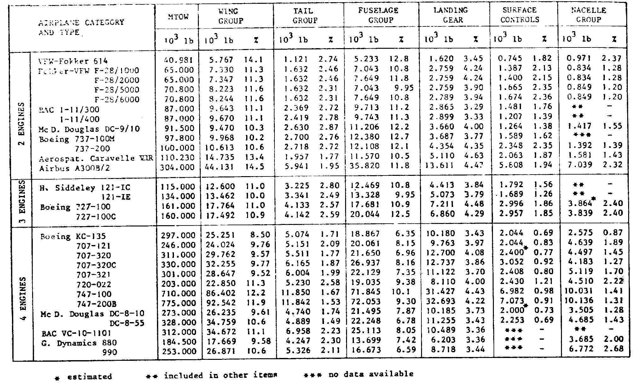
Some reference data to compare your results with
Jet transport
Have a look at the typical MTOW fractions of the various component groups. Whatever you did design, you should not be far from there
Source Torenbeek

Slide 49
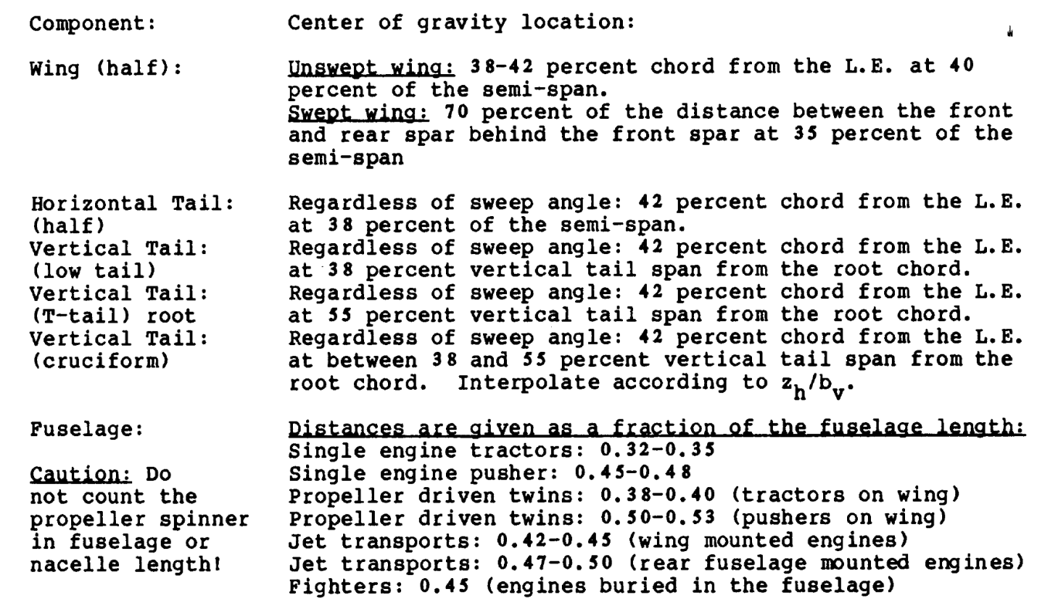
Estimation of the aircraft c.g. position at OEW
To compute the c.g. position of the operative empty aircraft, it is necessary to know the location of all the weight components with respect to the aircraft reference system.
centerline
fuselage skin
wing group CG at 0.7(X_{rs}-X_{fs})
mean aerodynamic chord (MAC)
front spar at 0.25C
rear spar at 0.55C to 0.6C
0.35b/2
Y_{MAC}
b/2
Example of component c.g. location information (source Roskam)
Notes:
*Find relevant information on the component center of gravity location, in the reference books (torenbeek, roskam, raymer, corke) extracts posted on BB (those with the class II weight estimation methods)
Use your technical drawings and engineering judgement to locate the position of the various components with respect to the aircraft.

Slide 50
Estimation of the aircraft c.g. position at GW
What about the c.g. position in presence of payload and fuel?
How does it change when fuel is burnt during mission, or during loading/unloading of passengers?
Example of aircraft loading diagram
We will learn to build these plots next year in AE3211-I
Notes:
GW gross weight: see definition earlier in this set of slides

Slide 51
Class II weight prediction methods - availability
A number of Class II weight prediction methods are available on classical Aircraft Design text books.
Though often restricted to specific aircraft categories and typically based on relatively old aircraft data, they nicely serve educational purposes:
E. Torenbeek, Synthesis of Subsonic Airplane Design, Chapter 8
J. Roskam, Airplane Design, Part V: Component Weight Estimation
D. Raymer, Aircraft Design – A conceptual approach, Chapter 15
T.C. Corke, Design of Aircraft, Chapters 2 and 11
L.R. Jenkinson, Civil Jet Aircraft Design, Chapter 7
I. Kroo and R. Shevell, Aircraft Design: Synthesis and Analysis, Web Book from Stanford University, available at: http://adg.stanford.edu/aa241/structures/weights.html
Notes:
Though copies of all these books are available in our library, some extracts are made directly available on BB to facilitate your study work.

Slide 52
2.1: Estimation of the load factor

Slide 53
Examples of a Class II weight estimation methods
The corrective coefficients have been derived on the base of extensive databases of actual aircraft weights using regression analysis.
Hence, these rules can well predict the weight of designs that do not differ significantly from those included in the database
N_{z} is the ultimate design load factor
= 1.5 times the maximum design load factor n_{max}
Notes:
Source Raymer

Slide 54
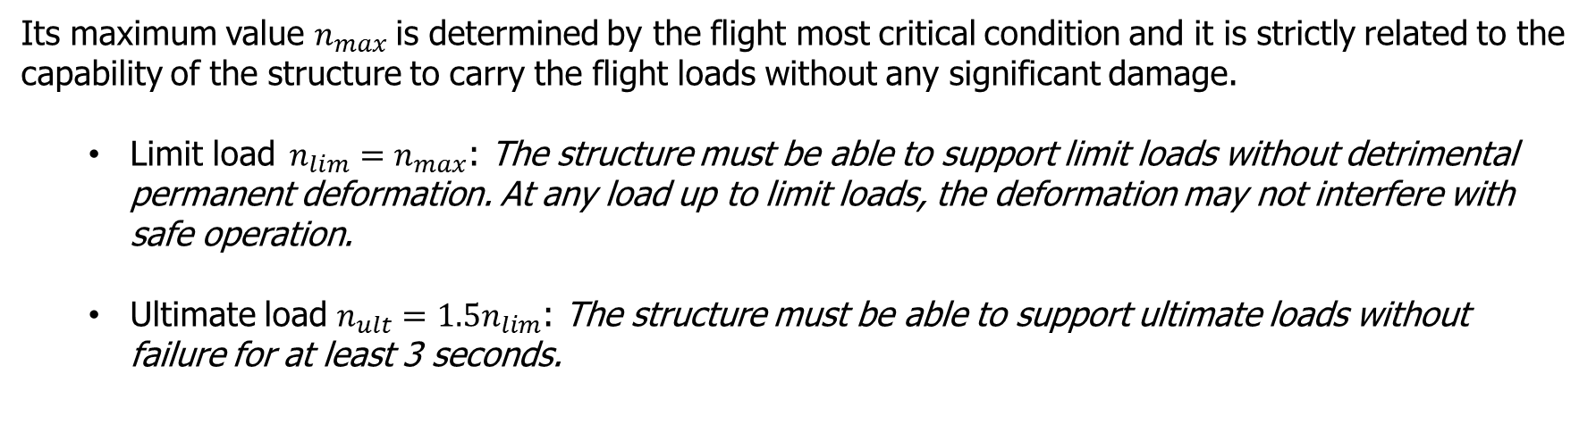
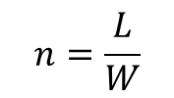
The Load Factor n
The (vertical) load factor is defined as the Lift to Weight ratio:
$$n=\frac{L}{W}$$
Its maximum value $n_{max}$is determined by the flight most critical condition and it is strictly related to the capability of the structure to carry the flight loads without any significant damage.
Limit load $n_{lim}=n_{max}$: The structure must be able to support limit loads without detrimental permanent deformation. At any load up to limit loads, the deformation may not interfere with safe operation.
Ultimate load ${n_{ult}=1.5n}_{lim}$: The structure must be able to support ultimate loads without failure for at least 3 seconds.
We have to define the critical flight condition in order to determine the value of the limit and the ultimate load factors
Notes:
Most of the class II weight prediction rules require as input the ultimate design load factor (1.5 times the maximum design load factor).
If you come across a class II wing weight estimation method that is not depending on the load factor…throw it away, it cannot be good!
Maximum design load factors are typically specified as top level requirement for aerobatic and military (trainer) aircraft.
In any other situation, the maximum design load will have to be calculated as the highest between the maximum load factor generated by manoeuvres and gusts, as specified by the certification authorities and described in the CS.
In other words, CSs specify the way to compute the minimum maximum load factors, which the aircraft must be able to sustain, in order to be certified airworthy. You cannot design and aircraft that is not able to meet at least the load factors prescribed by CS.
Certification regulations describe how to build these 2 diagrams (i.e. the manoeuvre and the gust load), which are essential to the whole certification process. Indeed, manufacturers will have to demonstrate the aircraft capability to sustain all the loads factors of the manoeuvre and gust envelope.

Slide 55
Determination of the Load Factor n
Flight maneuver envelope
The maximum flight manoeuvre load factors depend on the aircraft weight category
Gust envelope
The gusts induced load factors depend on the gust sensitivity of the aircraft, which increases with C_{Lα} and with the inverse of the wing loading
Notes:
Most of the class II weight prediction rules require as input the ultimate design load factor (1.5 times the maximum design load factor).
If you come across a class II wing weight estimation method that is not depending on the load factor…throw it away, it cannot be good!
Maximum design load factors are typically specified as top level requirement for aerobatic and military (trainer) aircraft.
In any other situation, the maximum design load will have to be calculated as the highest between the maximum load factor generated by manoeuvres and gusts, as specified by the certification authorities and described in the CS.
In other words, CSs specify the way to compute the minimum maximum load factors, which the aircraft must be able to sustain, in order to be certified airworthy. You cannot design and aircraft that is not able to meet at least the load factors prescribed by CS.
Certification regulations describe how to build these 2 diagrams (i.e. the manoeuvre and the gust load), which are essential to the whole certification process. Indeed, manufacturers will have to demonstrate the aircraft capability to sustain all the loads factors of the manoeuvre and gust envelope.

Slide 56
Load factor n
Flight maneuver envelope
The maximum flight manoeuvre load factors depend on the aircraft weight category
gust envelope
The gusts induced load factors depend on the gust sensitivity of the aircraft, which increases with C_{Lα} and with the inverse of the wing loading
Home Exercise:
Use the quick guide to build V-n diagrams, based on CS, available on BS to generate an example diagram
You can also refer to the document for the second year project AE2100 (also on BB)
Notes:
Most of the class II weight prediction rules require as input the ultimate design load factor (1.5 times the maximum design load factor).
If you come across a class II wing weight estimation method that is not depending on the load factor…throw it away, it cannot be good!
Maximum design load factors are typically specified as top level requirement for aerobatic and military (trainer) aircraft.
In any other situation, the maximum design load will have to be calculated as the highest between the maximum load factor generated by manoeuvres and gusts, as specified by the certification authorities and described in the CS.
In other words, CSs specify the way to compute the minimum maximum load factors, which the aircraft must be able to sustain, in order to be certified airworthy. You cannot design and aircraft that is not able to meet at least the load factors prescribed by CS.
Certification regulations describe how to build these 2 diagrams (i.e. the manoeuvre and the gust load), which are essential to the whole certification process. Indeed, manufacturers will have to demonstrate the aircraft capability to sustain all the loads factors of the manoeuvre and gust envelope.

Slide 57
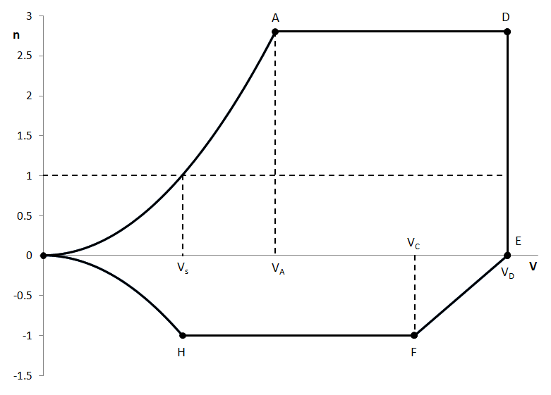
Generation of V-n diagrams
Maneuver load diagram
n_{max} prescribed by CS*
n=qC_{Lmax}/(W/S)
n_{min} prescribed by CS*
Vs: Stall speed
V_{A}: maneuver speed
V_{c}: cruise speed
V_{D}: dive speed
Notes:
n=L/W
the load factor n is defined as the ratio between the lift generated by the aircraft and its weigh. Below stall speed the aircraft cannot reach n=1, i.e. cannot generated sufficient lift to counteract its own weight
VA is the minimum speed at which it is possible to reach nmax
Vd is the dive speed which is larger than cruise speed. Regulations specify its minimum value.
nult=1,5nmax
nmax is function of MTOW
*see next slide for the n_{max/min} values per aircraft category. Please note that the values prescribed by the CS are actually the minimum for which the aircraft should be certified. Manufacturers are free to design for higher nmax (or more negative nmin)

Slide 58
Generation of V-n diagrams
Maneuver load diagram
For the estimation of the maximum design load factor (n_{max}) of large transport aircraft you can use this table from the Certification Specification:
Notes:
A similar table is provided on the CS for nmin
nult=1,5nmax
nmax is function of MTOW

Slide 59
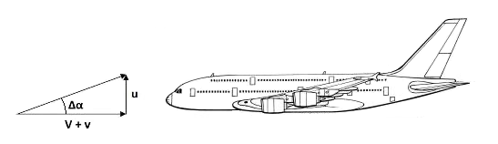
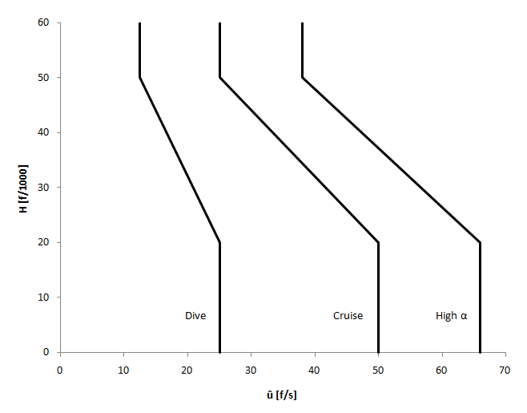
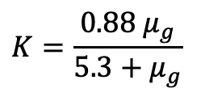
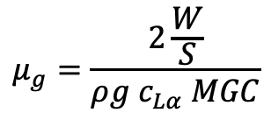
Generation of V-n diagrams
Gust load diagram
Statistical gust velocities
$$μ_{g}=\frac{2\frac{W}{S}}{ρ{g c}_{Lα} MGC}$$
$$K=\frac{0.88 μ_{g}}{5.3+μ_{g}}$$
Notes:
K depends on the aircraft speed regime (subsonic or supersonic)
the higher the wing loading the less sensitive to gust is the aircraft. Viceversa for the lift gradient.
Higher gust speeds are experienced at lower altitude
A pilot will not dive or cruise at max speed in presence of large perturbations, that is why the statistical gust speed at low flying speed (high angle of attack) are the largest and those at dive speed the lowest.

Slide 60
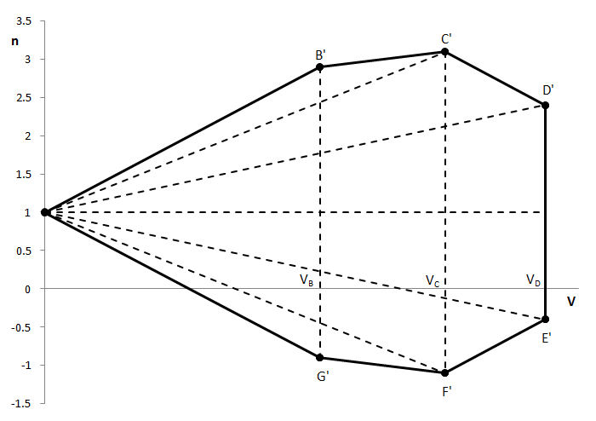
Generation of V-n diagrams
Gust load diagram
V_{B}: high lift at max a.o.a.
V_{c}: cruise speed
V_{D}: dive speed
Notes:
Gust must be evaluated at 3 speed values

Slide 61
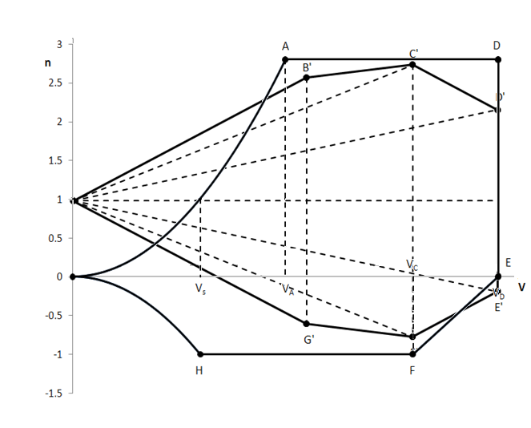
Generation of V-n diagrams
Gust load diagram
V_{B}: high lift at max a.o.a.
V_{c}: cruise speed
V_{D}: dive speed
Notes:
Gust must be evaluated at 3 speed values

Slide 62
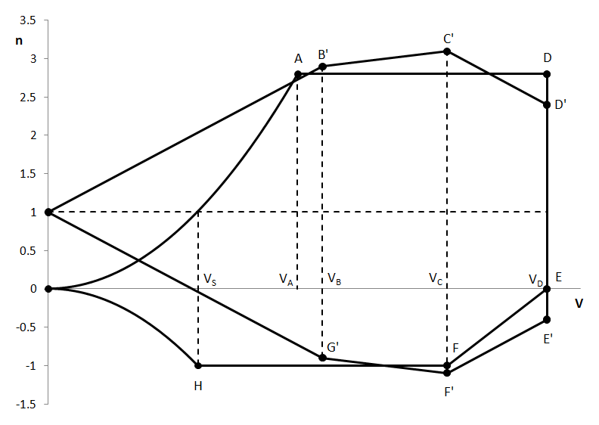
Generation of V-n diagrams
Maneuver and Gust load diagrams
This is the value to be used to compute n_{z} for the class II weight estimation
n_{max}
Notes:
The example in Figure A.6 is representative of possible case for transport aircraft where gust loads are dominant. However, this is not always the case, as the incremental load factor due to gust depends on the flight conditions chosen in the mission of the aircraft, the wing loading and the lift gradient coefficient of the wing ). Equation A.7 shows that aircraft with higher wing loading are less sensitive to gust, whilst higher values make the aircraft more sensible to gust. This can be easily explained by the fact that a higher or higher wing surface S (for a given aircraft weight) yield a higher with a certain angle of attack, and thus a larger increment of lift.
Given the sensitivity of the maximum load factors with wing loading and altitude (via the air density), the CS require the generation of V-n diagrams:
(1) At each critical altitude within the range of altitudes selected by the applicant;
(2) At each weight from the design minimum weight to the design maximum weight appropriate to each particular flight load condition; and
(3) For each required altitude and weight, for any practicable distribution of disposable load within the operating limitations recorded in the Aeroplane Flight Manual.

Slide 63
2.2: Managing weights calculation during the design

Slide 64
Recall on the overall conceptual design procedure
Requirements
Initial Layout
Revised Layout
Concept selection
Aero
Aero
Propulsion
Prop & Systems
Struct weight
Constraints diagram
Flight mech.
Mission Analysis
End, Conceptual conf. freeze
Weight
Costs
References and first guess
First sizing
Conv?
Refined sizing
Class I sizing
Class II sizing

Slide 65
Applying Class II methods
Class I application
Class II application
Class II results
OEW₁
What if OEW_{i+1} ≠ OEW_{i} ?
Mission +
OEW/MTOW
Iterate until perc. diff < 1%
Be aware of the consequences!!!
OEW_{i}
And if OEW₁ ≠ OEW₂ ?
The iteration involves all the class I and the aerodynamic analysis!
OEW₂
Notes:
An initial operative weight estimate OEW₁ is derived using a Class I methods (which is generally based on an initial assumption of the ratio OEW/MTOW from statistics). This value is then used for the estimation of the aircraft component weights by means of a class II method. Indeed, several component weights are computed as function of OEW, or MTOW, or MZFW, or anyhow weights, which, indirectly, depend from the initially assumed ratio OEW/MTOW.
When the revised OEW weight is found (as outcome of a class II method, by adding all the structural component weights) it may differ from the initial value derived from the Class I method! This is because the weight of the various components are estimated using different types of function (e.g. linear, quadratic, etc.) of different type of weight figures (e.g. take-off weight, or MTOW, or MZFW, etc..). Also, class II weight estimations depend on all the design decisions made after the Class I weight estimation, such as the geometry of the aircraft (e.g., the size and shape of the wing), which might significantly differ from the geometry of the airplanes used to derive the initial Class I weight estimates.
This means that some iteration is generally required to guarantee consistency to the overall process.
If the difference between the initial and the revised weight is small enough, few iterations will be sufficient to bring the difference to a sufficiently low value and allow proceeding with the design.
Thus, the initial OEW estimate, denoted in the slide above by OEW₁ leads to a revised weight, OEW₂. This value is now used to compute a new value of the ratio OEW/MTOW, which will be used as the starting point for a new application of the class I method.
If the difference is such that (OEW_{n+1} – OEW_{n})/OEW_{n} is less than, say 1%, then the iteration process may be halted and the last value will be considered for the revised evaluation of the take-off weight.
Of course, all the component weights will be those corresponding to the final choice of the take-off weight.
Be aware that the fuel weight (computed with the cla I method) will be generally affected by these iterations . Besides, in order to maintain the previously selected design point (i.e., the selected combination of T/W and W/S), a new value of T will be derived (maybe a different engine?) as well as a new wing surface area S, with all the associated consequences (e.g. revised high lift devices).
It is generally convenient to compare the obtained weight for the various aircraft components (in terms of MTOW ratio), with those of some reference aircraft. Large differences could be a signal of peculiar/extreme design decisions (e.g., during the sizing process of the wing, a particularly high aspect ratio might have been selected than for reference aircraft), but can also raise issues on the applicability of the class II equations to such a peculiar design. See next slides for a collection of component weight fractions for aircraft of different categories.

Slide 66
Mission definition
fuel fractions
L/D
SFC
OEW/MTOW
N² charts* to map the design process and help managing iterations
Class I weight estimation
OEW
MTOW
Fuel weight
OEW
Can you spot any weight estimation iteration?
OEW₁ and OEW₂ ?
How would you manage it?
Engine selection
Fuselage sizing
Wing sizing & preliminary positioning
Preliminary tail sizing & positioning
L/D
SFC
3D views
n_{ult}
Class II weight estimation
c.g. determination
OEW
c.g. range
OEW
?
Tail sizing & positioning
Wing positioning
Landing gear positioning
?
Tail size and position
Wing position
Landing gear position
L/D
Notes:
This sort of N2 charts, which illustrates in a very compact way the flow of a process (with all its computation blocks and relative input/output data) with all its iterations, is also called DSM (Design Structure Matrix).
By definition, all the process transformations (the computation blocks) are displayed along the diagonal of the chart; all the data feedforward from one block to the others are displayed above the diagonal; all the feedback data below the diagonal. It is also possible to put all the feedforward below, and all the feedback above the diagonal. The arrows at the corners indicate the way to read such matrix.
Important: Never mix feedforward and feedback data above or below the diagonal!!!
Try to answer these two questions:
Why does the tail sizing and wing positioning process affect L/D?
Why are we talking here of “c.g. range” rather than simply c.g. position?

Slide 67
During this lecture…
You have been confronted with the issues related to weight prediction and control in aircraft design
You have learnt what are the typical weight prediction methods and how they allow you to monitor and detail the a/c weight, during all the design phases
You have learnt the working principles of class II weight predictions methods, their strength and limitations
You have learnt the meaning of load factor and the procedure to calculate its envelope of rboth maneuver and gust reason
You have learnt how to deal with the iterations required to maintain consistency between results from different classes of weight prediction methods

Slide 68


Wing design check list and troubleshooting
Notes:
68

Slide 69
Wing Design check list. Is our wing design good enough?
Is my wing operating in cruise at very high CL, too close to stall conditions?
Fly at lower altitude, increase speed, use different airfoils, increase wing surface...anyhow don’t use flaps in cruise!! Make sure to use high aspect ratio to reduce induced drag, consider using wingtip devices
Is my lift distribution close enough to the elliptical distribution?
If not AND you are aiming for minimum induced drag then adjust the taper ratio value and/or twist adequately the wing (ATT! anytime you modify the taper ratio, check its combination with the sweep angle value). If you are looking for a good compromise between wing weight and induced drag, aim for a more triangular/elliptical distribution. Still use the taper ratio and twist angles as main tuning parameters..
Notes:
69

Slide 70
Wing Design check list. Is our wing design good enough?
Does my wing show any pitch up tendency?
Change combination of sweep and aspect ratio, double check horizontal tail position, put a limiter on angle of attack, apply some negative twist (washout) to the wing tip sections, use tip airfoils with high lift coefficient.
What about the stall characteristics?
Be careful of tip stall risk: increase taper value, reduce sweep, use tip airfoils with high lift coefficient.
Does my structural design look feasible?
If not, increase root thickness (use thicker airfoil at the root, or change the taper ratio in order to have a longer root chord), shorten the wing span, decrease sweep angle (adapt airfoil for that).
Notes:
70

Slide 71
Wing Design check list. Is our wing design good enough?
Is your flapped wing able to deliver the required CLmax at take off and landing (at an acceptable angle)?
If no, then increase size of high lift devices (cf/c and Sf/S), change type of high lift devices, change type of airfoil (higher Clmax, better sharpness factor), increase wing area to lower W/S (hence the required CLmax), increase T/W is the problem is at takeoff, rediscuss takeoff and landing requirement.
Is the size of high lift devices compatible with wing size?
If not possible to increase high lift devices area (neither chord wise because moving spars makes structure weak and fuel tank volume insufficient; nor spanwise because space required by ailerons) change type of high lift devices, consider the combined use of high lift devices as ailerons*, consider chord extensions at the root to limit the negative effect of the sweep angle, increase wing surface to lower CLmax, relax the take off and landing performances.
Notes:
71
Not too uncommon in certain fighter aircraft. Of course the aileron function can only be compatible with simple hinged flaps (not with fowler types).
Aircraft such as the Tornado have the whole TE edge covered by a double slotted flap systems, so no aileron at all on the wing! The horizontal full-flying tailplanes can be controlled differentially to be used as ailerons (tailerons).

Slide 72
Wing Design check list. Is our wing design good enough?
Is there enough space for the fuel in the wing?
Verify that that your wing volume estimation method is not too conservative, make sure to use also the wing center section (the wing part inside the fuselage, move spars further apart from each other (but be careful with wing box structural performance), increase wing thickness, move the position of maximum thickness in a more convenient position, move part of fuel somewhere else on the aircraft
Do my airfoils work below Mach drag divergence even when the aircraft is flying at max operative speed?
If not, change airfoil type, reduce airfoil thickness, increase sweep angle, accept the fact you cannot find an airfoil that can operate at the required CLdes in correspondence of its Cldes (i.e., accept to pay a drag contribution), reduce design speed, lower operational altitude, increase wing area to reduce the required aircraft CLdes, hence the airfoil required Cl.
Notes:
72

